Slide 1
Build a CI/CD Pipeline
Used tools: Git, Jenkins, Docker, Ansible, Kubernetes
By: K S

Slide 2
Objective
Design and build a CI/CD pipeline using some Devops tools like GitHub, Jenkins, docker and ansible to deploy 3 replicas of a flask application to a Kubernetes cluster.

Slide 3
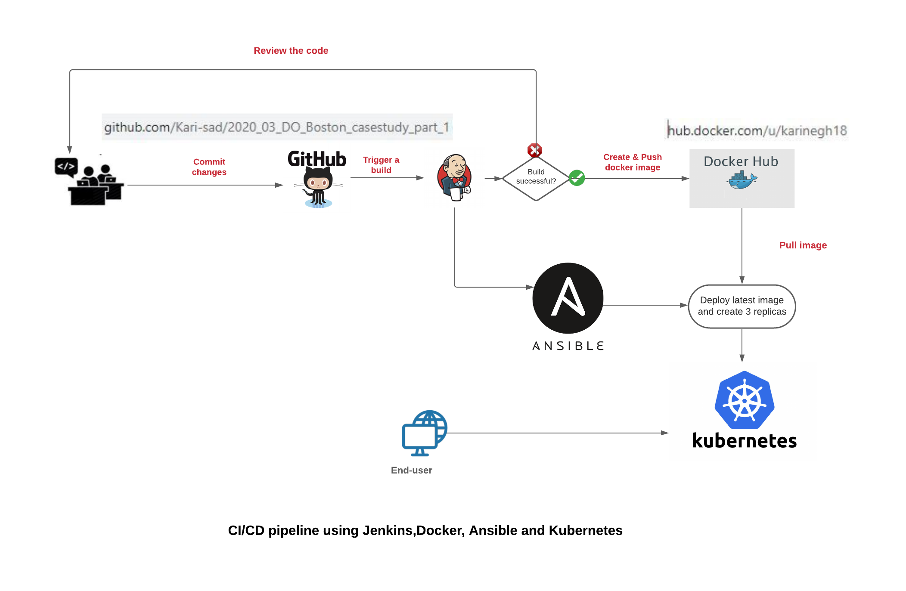
CI/CD pipeline design

Slide 4
CI/CD pipeline Build
Fork the the project’s repository that contains the flask app.
Generate a requirments.txt. Write a Dockerfile that will be used to dockerize our app and commit them to github repo
Set a git Poll SCM in jenkinks to trigger a build each 5 min (or set webhook if possible)
Write a jenkinsfile pipline that will:
Pull the code from the GitHub repository,
Build and test it using a relevant Docker image.If build fails, notify developpers.
Dockerize and push the application to Docker Hub.
Finally, use Ansible to deploy 3 replicas of the application to target environment, that is running Kubernetes. Ansible will use a playbook.yaml file that we created and pushed to the repository.
Push the jenkinsfile to github. Watch the status of the build in Jenkins.

Slide 5
Lab Setup
To implement and test my pipeline, I created a virtual environment with two VMs (Network bridged)
VM1
Jenkins server Docker Ansible Git To be able to use k8s ansible module , you shoul run: sudo apt install python3-pip pip3 install openshift
VM2
Minikube K8s cluster Docker
SSH
Lubuntu 18.04
RAM 2GB
HDD 15 GB
ubuntu 20.04
RAM 2GB
HDD 20 GB

Slide 6
Jenkins project setup
Installed needed plugins:
Git
Docker
Ansible …
- Created a Jenkinsfile (see in details in the following slides) to run all stages of my CI/CD pipeline and was checked into my GitHub repo
In Jenkins, I setup a pipeline project.
Source: Github repo.
Build trigger : Poll SCM (couldn’t get webhook to work)
Script pipeline : Jenkinsfile

Slide 7
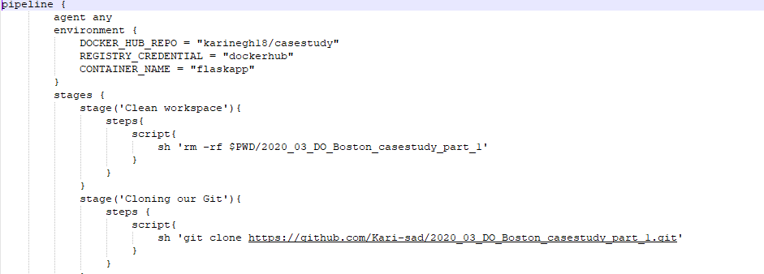
Jenkinsfile: part1
Environment variable:
Dockerhub repo and credential (detail in the following slide)
Clean workspace
Use git plugin to clone the github repository that contains our app

Slide 8
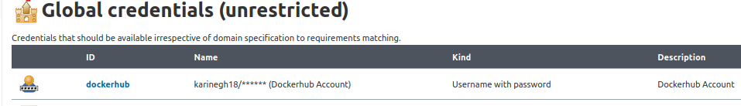
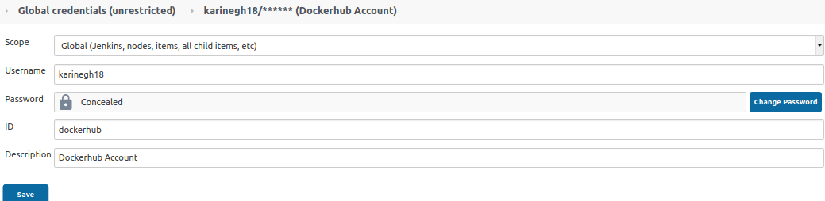
Jenkinsfile: part1
Detail of dockerhub credential setup in jenkins

Slide 9
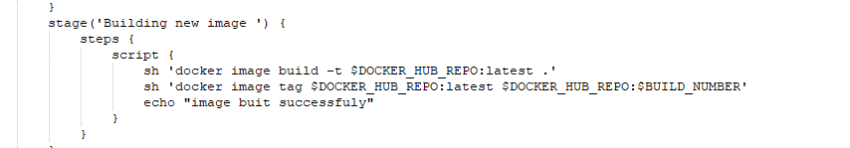
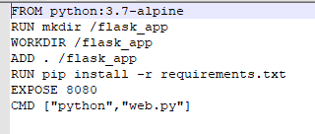

Jenkinsfile: part2
In this stage, a docker image is created using the Dockerfile .After creation a tag is assigned to it.
Requirements.txt

Slide 10
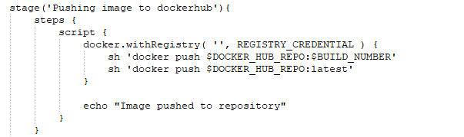
Jenkinsfile:part3
Push Image to dockerhub using credentials saved in jenkins creadentials

Slide 11
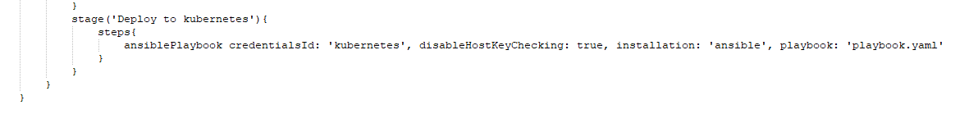
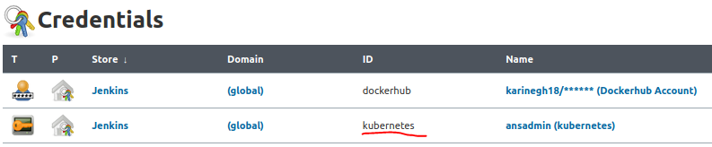
Jenkinsfile: part4
We will be using ansible plugin to deploy the app and publish the service using playbook.yaml
To avoid getting SSH error, I had to create a new credential in Jenkins by adding SSH private key . Credential id is kubernetes

Slide 12
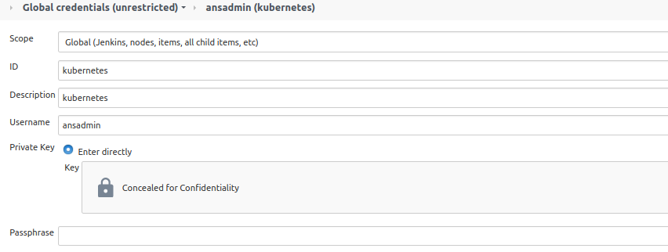

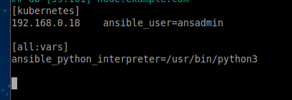
Jenkinsfile: part4
Detail of credential
Private key can be found
Ansible host file:

Slide 13
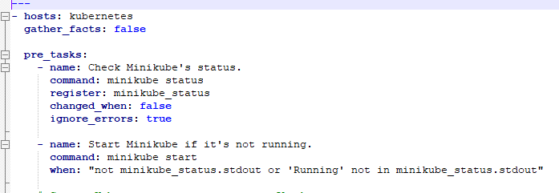
Playbook.yaml
Pre-tasks:
Check if minikube status. Start it if it’s not running.

Slide 14
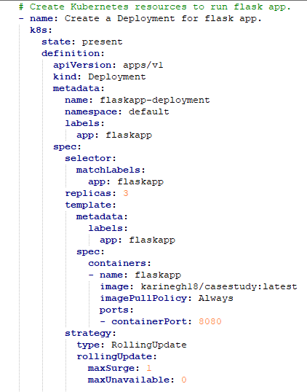
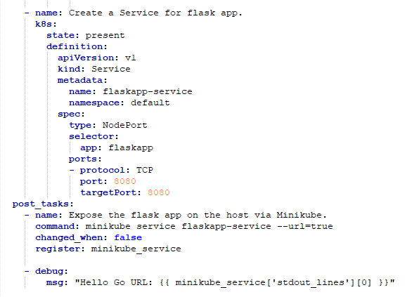
Playbook.yaml
Create deployment with 3 replicas
Create nodeport service
Important:
to be able to run k8s module you sould install openshift :
sudo apt install python3-pip
pip3 install openshift
Generate URL where the app can be accessed

Slide 15
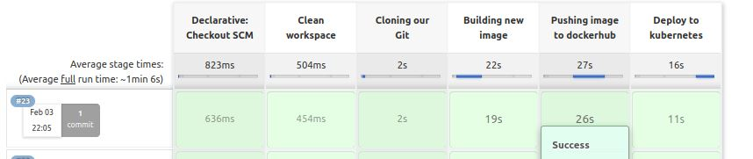
Screenshots
Execution summary of my pipeline

Slide 16
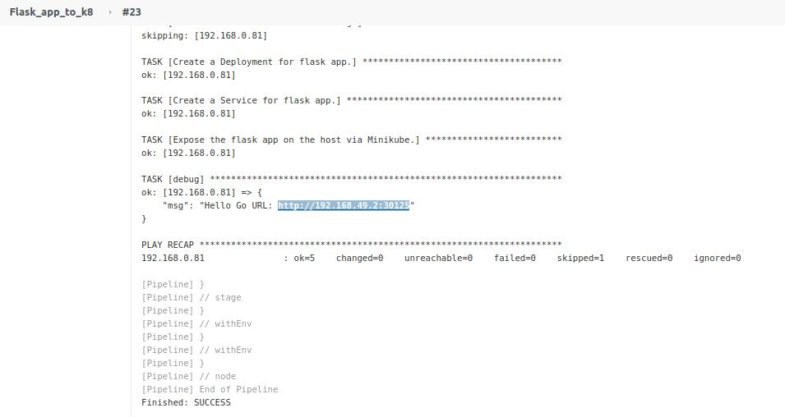
Screenshots
We can access the app using this link (in kubernetes host)

Slide 17
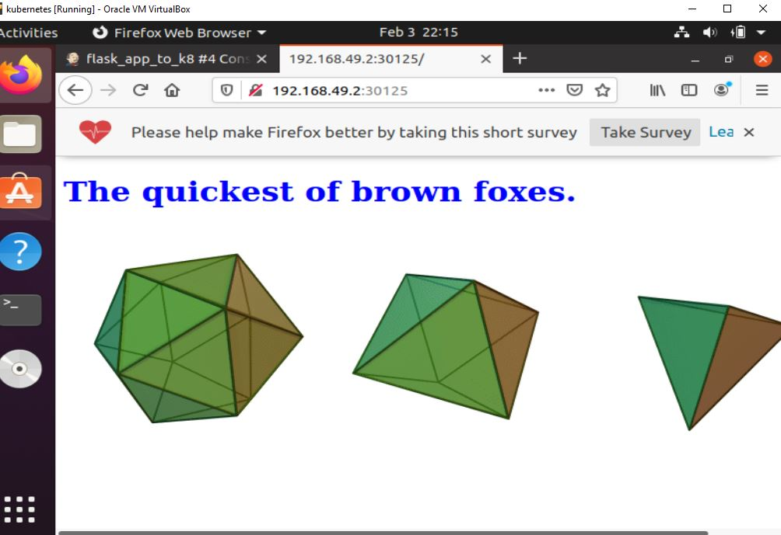
Screenshots

Slide 18
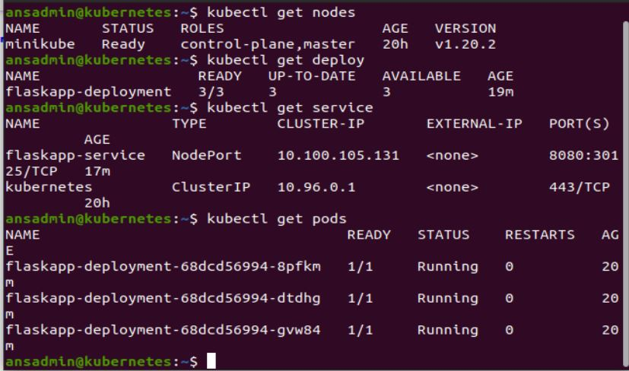
Screenshots

Slide 19
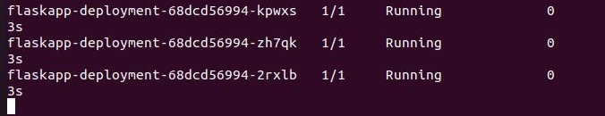
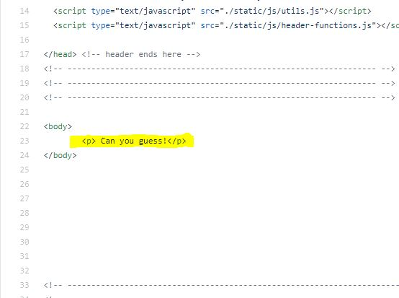
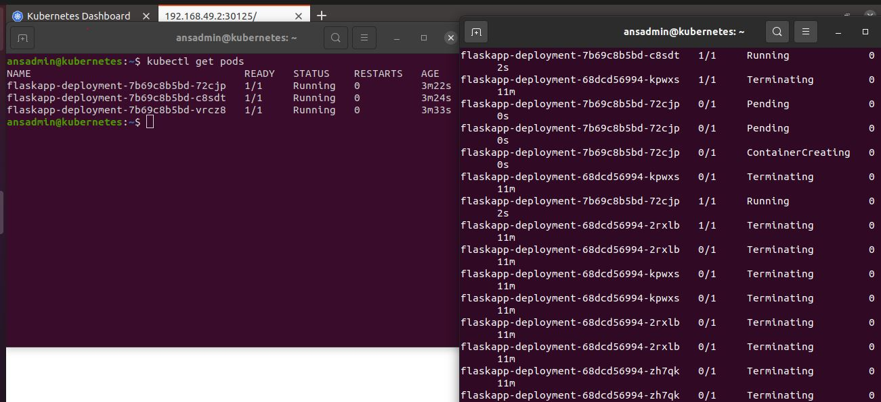
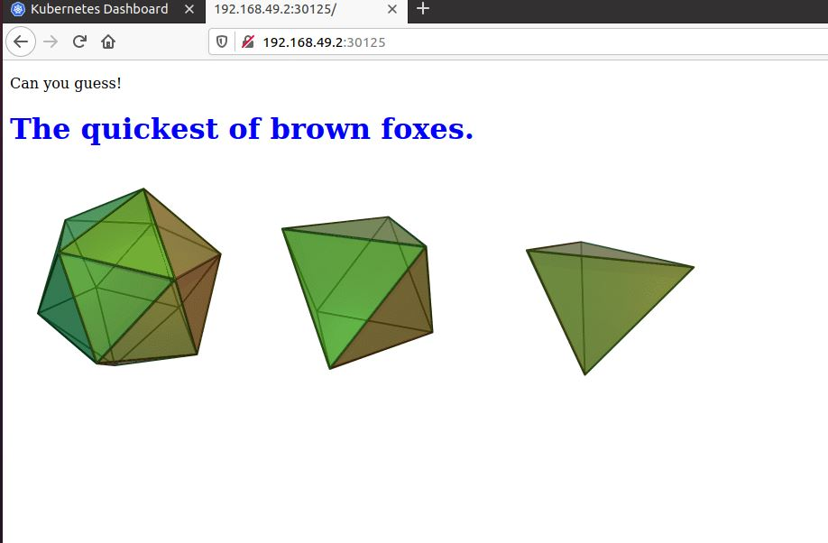
Demonstrating Zero-downtime Deployment Using Rolling Update strategy
Replace old pods with new ones gradually, while continuing to serve clients without incurring downtime
1- Original pods
2- Modify index.html
3-Watch nodes creation after triggering a new deployment
3-Update deployed with zero-downtime

Slide 20

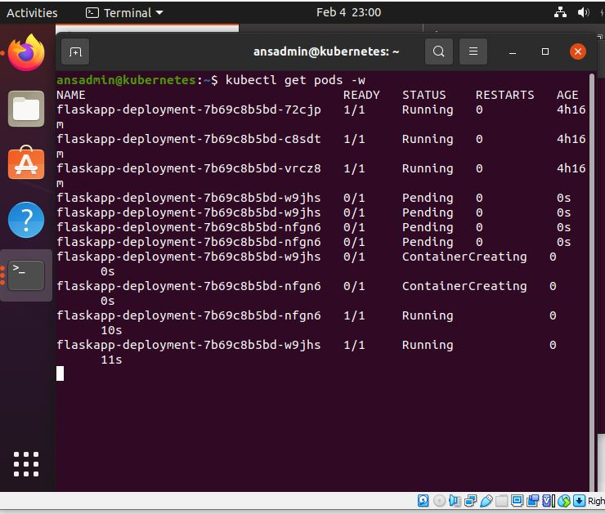
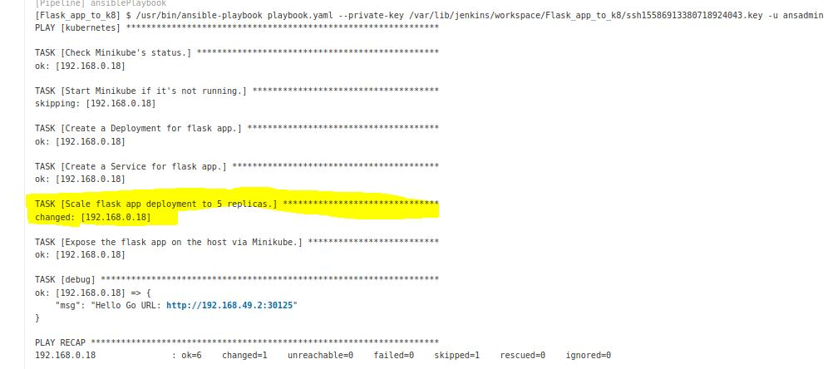
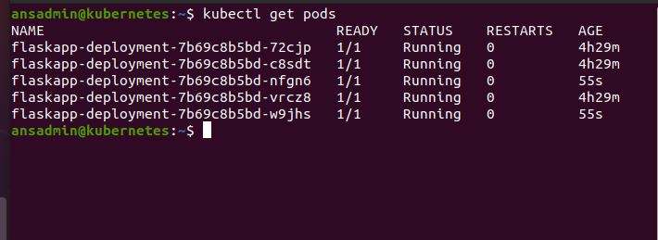
Scaling
Update the deployment by changing the replica’s from 3 to 5 and demonstrate that 5 pods are deployed on Kube.
1- Added these scaling script to my plybook and pushed to my github
3- Watch the creation of two new pods
2- Triggred a deployment from Jenkins using ansible (playbook.yaml)

Slide 21
Challenges
Hardware limitations to be able to set a kubernetes cluster instead of using minikube
Less knowledge on how to integrate Ansible with Jenkins (SSH issue when executing Ansible playbook from a Jenkins pipeline)

Slide 22
Takeaways
CI/CD is an integral part of any modern environment that follows the Agile methodology.
Through my pipeline, I have ensured a smooth transition of code from the version control system to the target environment I saw how Jenkins pipeline and Ansible makes it very easy and flexible to change the workflow with a very little friction
I saw also how using Kubernetes deployments ensured a zero downtime for the application when I was changing the container image. This was made possible by the rolling update deployment.

Slide 23
What’s next
Work on encrypting passwords used in this project
Reproduce this CI/CD in a cloud environment: AWS, Google Cloud, Azure.

Slide 24
To sum up
Setting the whole CI/CD from servers installation and configuration in a linux environment to pipeline design and build using a bunch of Devops tools was a nice exercise
It allowed me to get more hands-on experience and familiarity with linux, Jenkins, docker, ansible , kubernetes and how they integrate together
Learning by doing

Slide 25
Useful links:
My project github repo:
https://github.com/Kari-sad/2020_03_DO_Boston_casestudy_part_1
My dockerhub:
https://hub.docker.com/u/karinegh18
Some used ressources:
https://www.stratoscale.com/blog/devops/practical-devops-use-case-github-jenkins-docker/
https://github.com/geerlingguy/ansible-for-kubernetes
https://dev.to/yogendra_tamang/deploy-flask-app-on-kubernetes-2-17pb
https://www.youtube.com/watch?v=13FpCxCClLY

Slide 26
QA
Thank you for your attention

